Slide 1


Hector Oliva
12 May 2025

Slide 2

Outline
Executive Summary
Introduction
Methodology
Results
Conclusion
Appendix

Slide 3
Executive Summary
Summary of methodologies
Summary of all results

Slide 4
Introduction
Project background and context
Problems you want to find answers

Slide 5

Section 1

Slide 6
Methodology
Executive Summary
Data collection methodology:
By API Lab Ungraded App
By Web Scraping
Perform data wrangling
Perform some Exploratory Data Analysis (EDA) to find some patterns in the data and determine what would be the label for training supervised models.Perform exploratory data analysis (EDA) using visualization and SQL
Perform interactive visual analytics using Folium and Plotly Dash
Perform predictive analysis using classification models
How to build, tune, evaluate classification models

Slide 7

Data Collection
Describe how data sets were collected.
Using Api and web scraping
You need to present your data collection process use key phrases and flowcharts
DATA
source
DATA
raw
DATA
api
DATA
apply
DATA
process
DATA
result

Slide 8
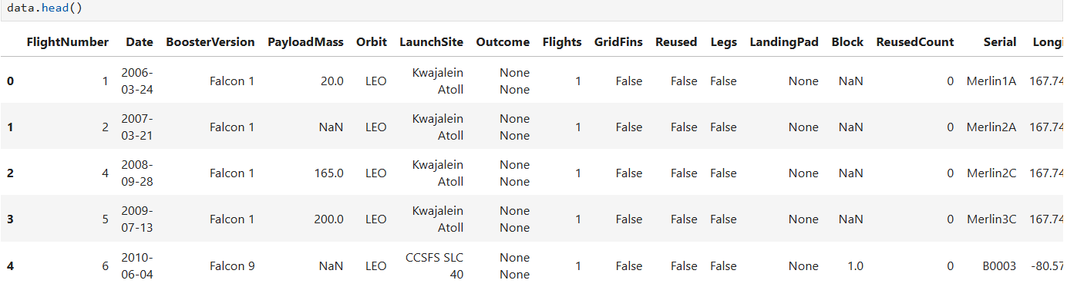
Data Collection – SpaceX API
Present your data collection with SpaceX REST calls using key phrases and flowcharts
Add the GitHub URL of the completed SpaceX API calls notebook (must include completed code cell and outcome cell), as an external reference and peer-review purpose

Slide 9
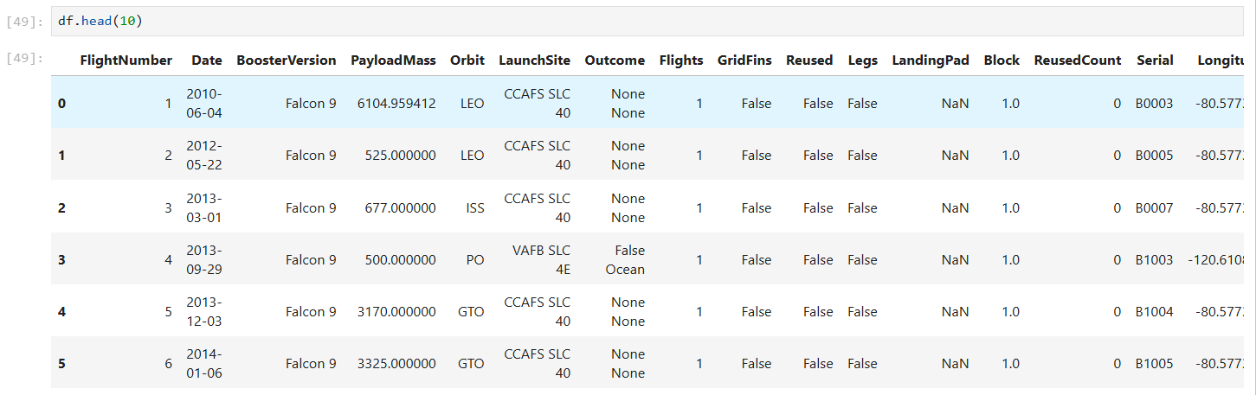
Data Collection - Scraping
Present your web scraping process using key phrases and flowcharts
Add the GitHub URL of the completed web scraping notebook, as an external reference and peer-review purpose
Place your flowchart of web scraping here

Slide 10
EDA with Data Visualization
Exploratory Data Analysis and Feature Engineering
Create scatter plots and bar charts by writing Python code to analyze data in a Pandas data frame
Write Python code to conduct exploratory data analysis by manipulating data in a Pandas data frame
Create and execute SQL queries to select and sort data
Utilize your data visualization skills to visualize the data and extract meaningful patterns to guide the modeling process

Slide 11
EDA with SQL
Using bullet point format, summarize the SQL queries you performed
Somenting…. For example:
%sql SELECT DISTINCT "Launch_Site" FROM SPACEXTABLE
%%sql SELECT * FROM SPACEXTABLE WHERE "Launch_Site" LIKE 'CCA%' LIMIT 5;
%%sql SELECT Date FROM SPACEXTABLEWHERE Landing_Outcome LIKE '%Success (ground pad)%'ORDER BY Date LIMIT 1
…. Others apply.

Slide 12
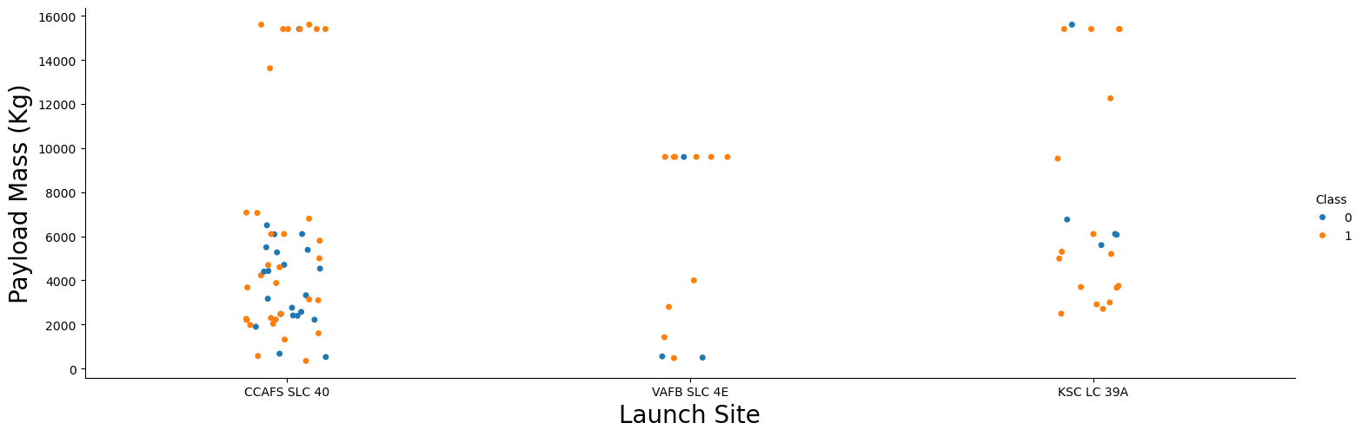
EDA with SQL

Slide 13
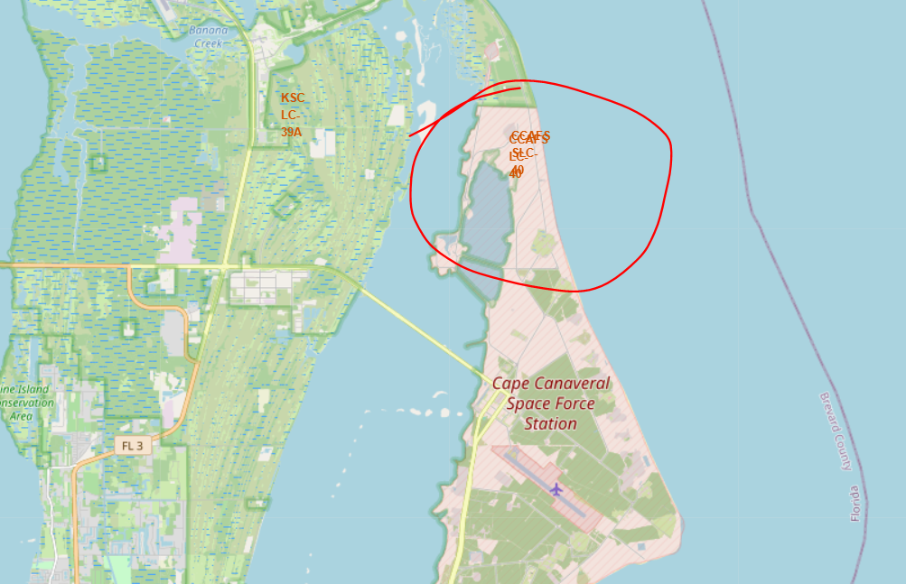
Build an Interactive Map with Folium

Slide 14
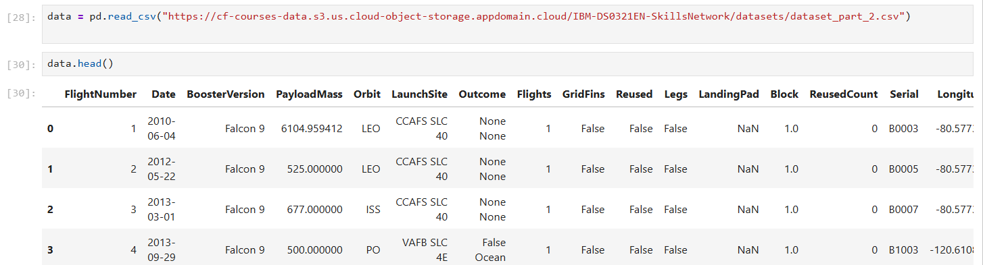
Predictive Analysis (Classification)
Find the best Hyperparameter for SVM, Classification Trees, and Logistic Regression.

Slide 15
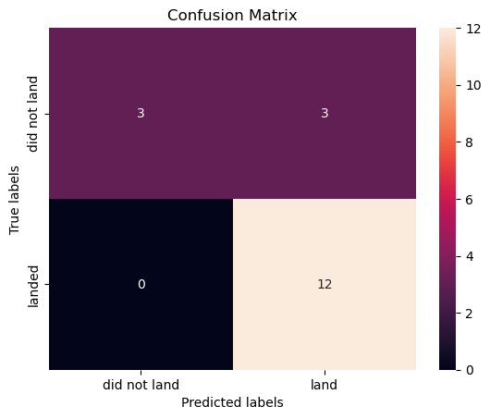
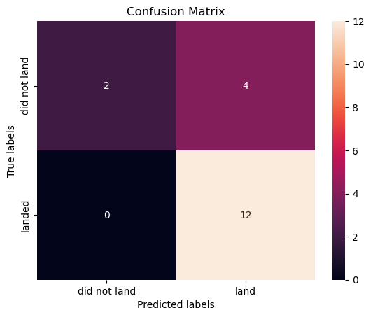
Results

Slide 16

Section 2

Slide 17
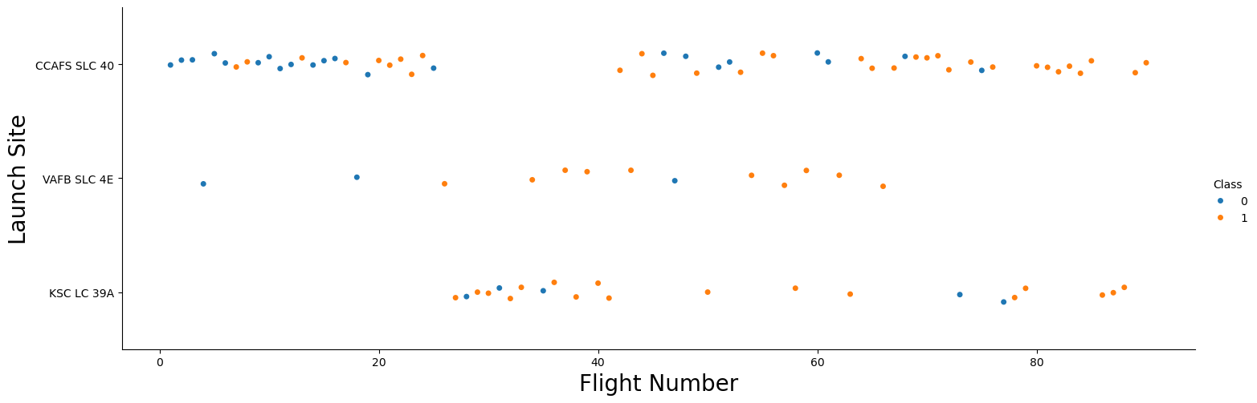
Flight Number vs. Launch Site

Slide 18
Payload vs. Launch Site

Slide 19
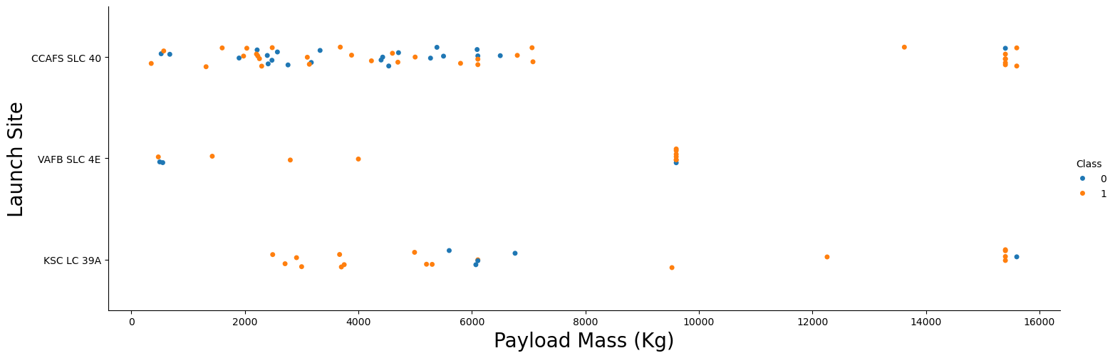
Payload vs. Launch Site

Slide 20
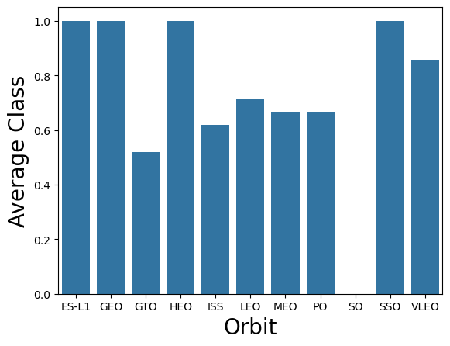
Success Rate vs. Orbit Type
Most important:
ES – GEO – HEO SSO

Slide 21
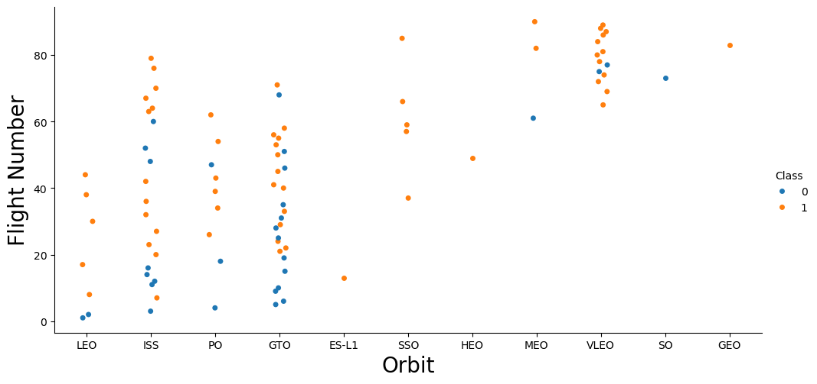
Flight Number vs. Orbit Type

Slide 22
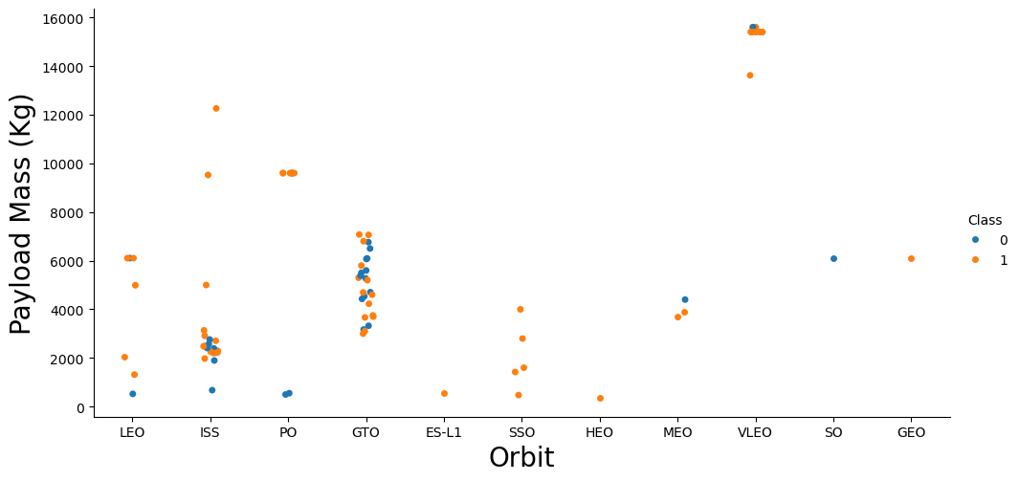
Payload vs. Orbit Type

Slide 23
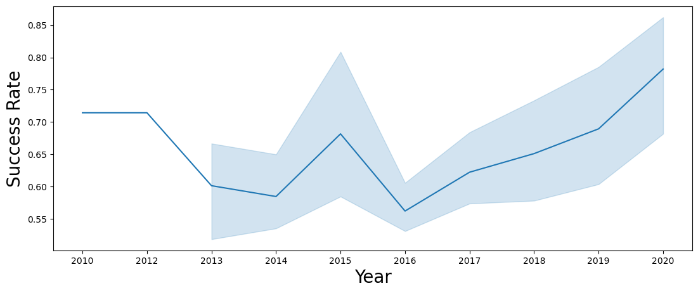
Launch Success Yearly Trend

Slide 24
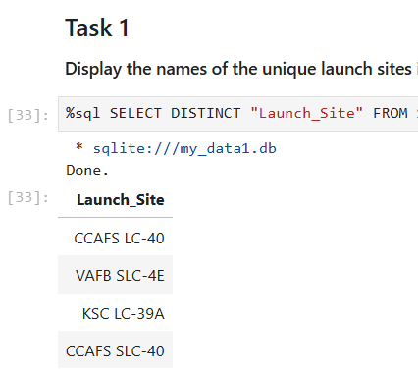
All Launch Site Names

Slide 25
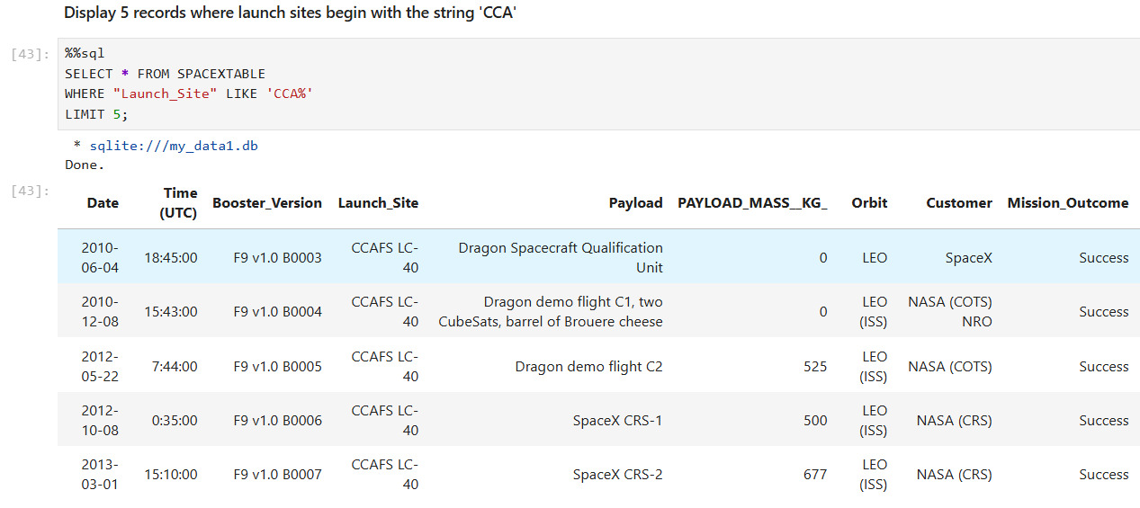
Launch Site Names Begin with 'CCA'

Slide 26
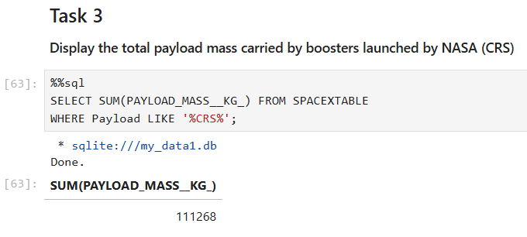
Total Payload Mass

Slide 27
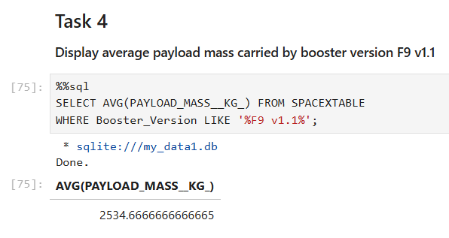
Average Payload Mass by F9 v1.1

Slide 28
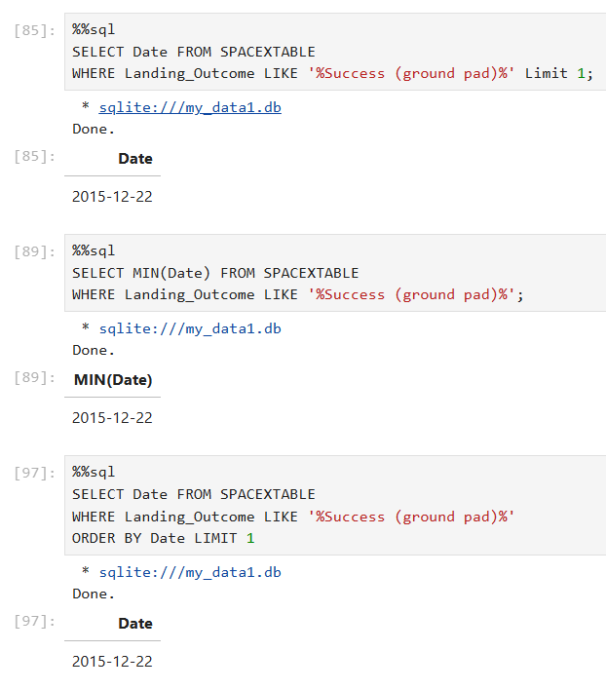
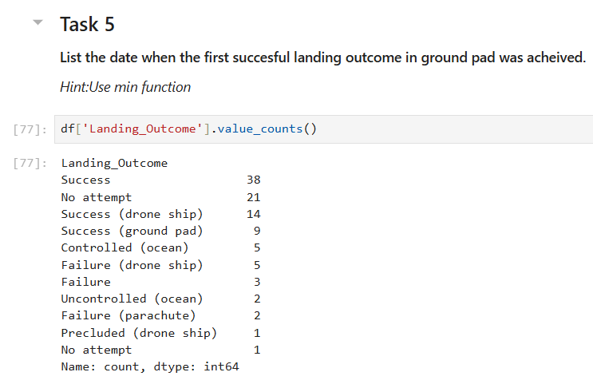
First Successful Ground Landing Date

Slide 29
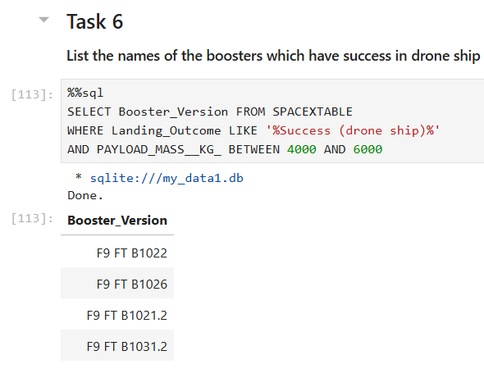
Successful Drone Ship Landing with Payload between 4000 and 6000

Slide 30
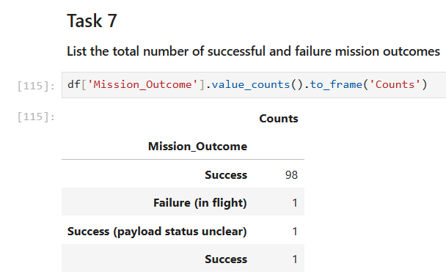
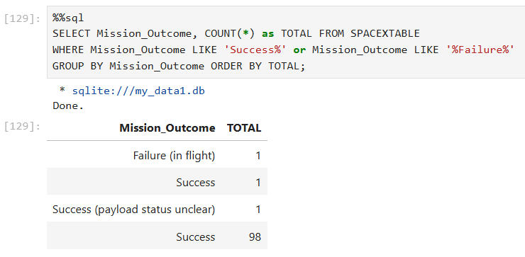
Total Number of Successful and Failure Mission Outcomes

Slide 31
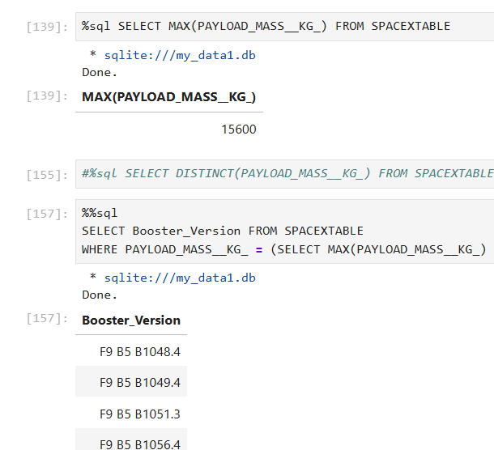
Boosters Carried Maximum Payload

Slide 32

Section 3

Slide 33
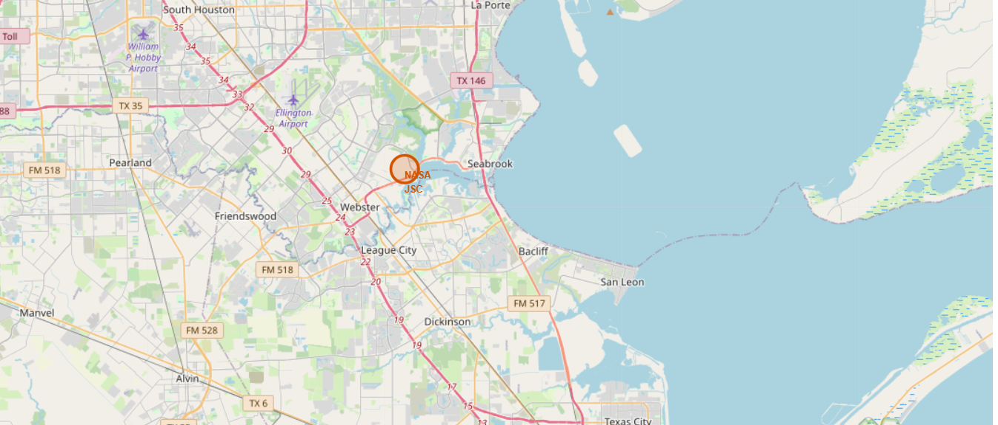
<Folium Map Screenshot 1>

Slide 34
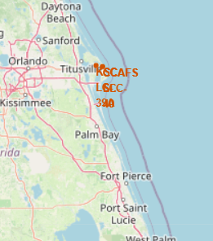
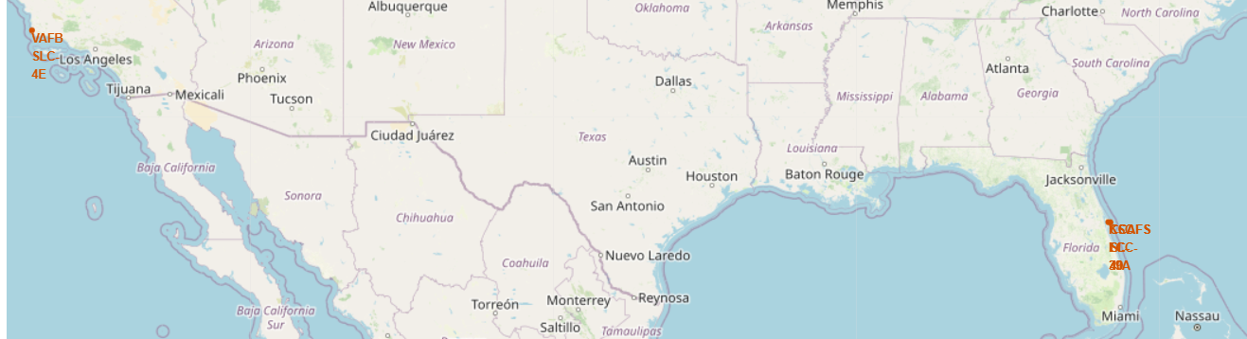
<Folium Map Screenshot 2>

Slide 35
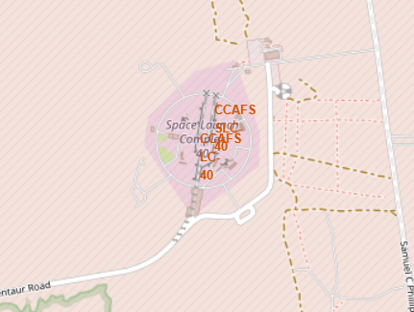
<Folium Map Screenshot 3>

Slide 36

Section 5

Slide 37
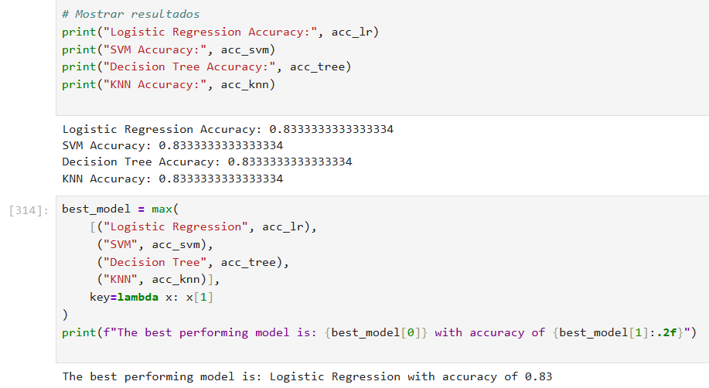
Classification Accuracy

Slide 38
Confusion Matrix

Slide 39
Conclusions
Launch Success Rate Increased Over TimeFrom 2013 onward, SpaceX significantly improved its launch success rate, with a notable upward trend in successful missions year by year.
LEO Orbit Shows Highest Success CorrelationLaunches targeting Low Earth Orbit (LEO) demonstrate a higher success rate, possibly due to simpler mission profiles compared to more complex orbits like GTO.
Launch Site Influences Success RateAmong the different launch sites, VAFB SLC-4E had a slightly lower success rate compared to KSC LC-39A and CCAFS LC-40, suggesting environmental or logistical differences may impact outcomes.
Payload Mass Has Limited Impact on SuccessThe payload mass alone does not strongly determine mission success; both heavy and light payloads have shown successful and failed outcomes depending on other variables.

Slide 40


